Slide 1
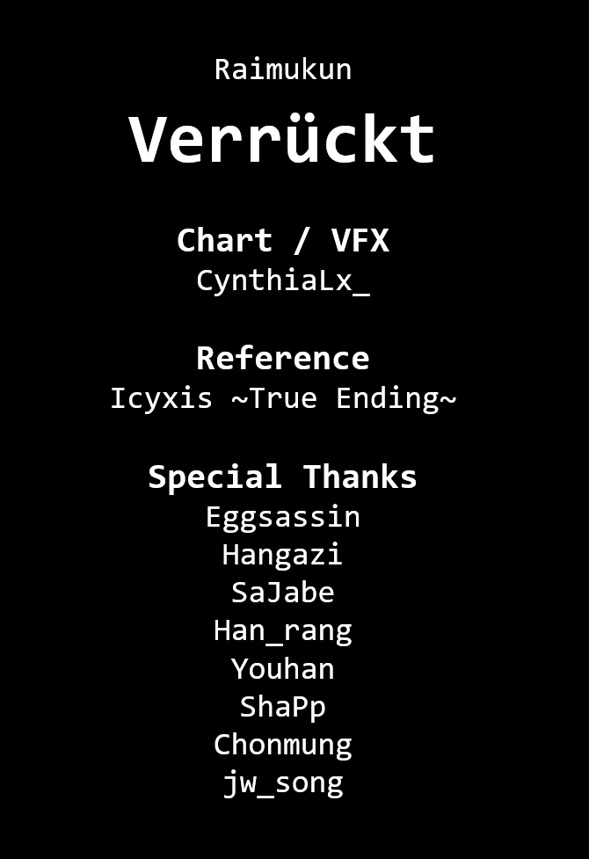
Raimukun
Verrückt
Chart / VFX
CynthiaLx_
Reference
Icyxis ~True Ending~
Special Thanks
Eggsassin
Hangazi
SaJabe
Han_rang
Youhan
ShaPp
Chonmung
jw_song

